Slide 1
bioMEDical Instrumentation system
By: Engr. Hinesh Kumar

Slide 2
Outline
Generalized Medical Instrumentation Systems
Components of Medical Instrumentation Systems
PC Based Medical Instruments Systems
Operational Modes
Medical Measurement Constraints
Classifications of Biomedical Instruments
Measurements Input Source
Characteristics of Instrument Performance
System Static & Dynamic Characteristics
General Design Criteria & Process of Medical Instruments
Commercial Medical Instrumentation Development Process

Slide 3
Basic Instrumentation System

Slide 4
Generalized Medical Instrumentation System
* Elements and connections shown by dashed lines are optional for some applications.

Slide 5
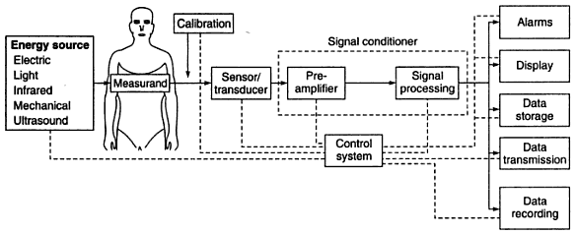
Generalized Medical Instrumentation System

Slide 6
Components of Medical Instrumentation System
Measurand
Sensor / Transducer
Signal Conditioning
Output Display
Auxiliary Components

Slide 7
Measurand
The physical quantity, property, or condition that the system measures is called measurand.
The accessibility of the measurand is important because it may be:
Internal (Blood Pressure)
On the Body Surface (Electrocardiogram)
Emanate from the body (Infrared Radiation)
Derived from Tissue Sample (such as Blood or a Biopsy)

Slide 8
Cont…
Most medically important measurands can be grouped in the following groups:
Biopotential,
Pressure,
Flow,
Dimensions (Imaging),
Displacement (Velocity, Acceleration, And Force),
Impedance,
Temperature, And
Chemical Concentrations
The measurand may be localized to a specific organ or anatomical structure.

Slide 9
Sensor
The transducer is defined as a device that converts one form of energy to another.
A sensor converts a physical measurand to an electric output.
The sensor should respond only to the form of energy present in the measurand, to the exclusion of all others.
The sensor should non invasive and minimally invasive.

Slide 10
Signal Conditioning
Simple signal conditioners may only amplify and filter the signal or merely match the impedance of the sensor to the display.
Often sensor outputs are converted to digital form and then processed by specialized digital circuits or a microcomputer.
For example, signal filtering may reduce undesirable sensor signals.
It may also average repetitive signals to reduce noise, or it may convert information from the time domain to the frequency domain.

Slide 11
Output Display
The results of the measurement process must be displayed in a form that the human operator can perceive.
The best form for the display may be:
Numerical
Graphical,
Discrete or Continuous,
Permanent or Temporary
Visual / Hearing

Slide 12
Auxiliary Components
A calibration signal with the properties of the measurand should be applied to the sensor input or as early in the signal-processing chain as possible.
Many forms of control and feedback may be required to elicit the measurand, to adjust the sensor and signal conditioner, and to direct the flow of output for display, storage or transmission.
The control and feedback may be automatic or manual.

Slide 13
Cont…
Data may be stored briefly to meet requirements of signal conditioning or to enable operator to examine the data that precede alarm conditions. Or data may be stored before signal conditioning, so that different processing schemes can be utilized.
Conventional principles of communication can often be used to transmit data to remote displays at nurses’ stations, medical centers, or medical data-processing facilities.

Slide 14
PC Based Medical Instruments
Personal computer are popular in medical field and also software is largely commercially available and the users can purchase and use it.
Computer are widely accepted in the medical field for data collection, manipulation, processing and a complete workstations for a variety of applications.
A personal computer becomes a workstation with the simple installation of one or more “instruments-on-a-board” in its accessory slots.

Slide 15
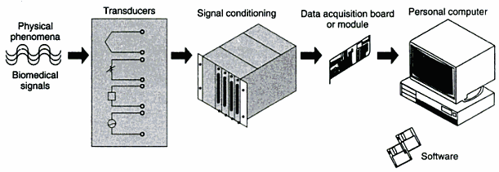
PC Based Medical Instruments
Typical configuration of PC based Medical Instruments

Slide 16
Cont…
Fig illustrates the typical configuration of a PC based workstation. System is highly flexible and can accommodate a variety of inputs, which can be connected to PC for analysis, graphics and control.
Basic elements in the system include sensors or transducers that convert physical phenomena into a measurable signal, a data acquisition system, an acquisition/analysis software package or programme and computing platform.
The systems works totally under the control of software.

Slide 17
Cont…
PC medical instruments are gaining in popularity for several reasons including price, programmability and performance specifications.
Software development, rather than hardware development, increasingly dominates new product design cycles.
This includes operating systems, devices drivers, libraries, languages and debugging tools.

Slide 18
Categories of Measurement
There are three general categories of measurement
Direct Measurement
Indirect Measurement
Null Measurement

Slide 19
Direct Measurement
Direct measurement are made by holding the measurand up to some calibrated standard and comparing two.
Example: Meter stick ruler used to cut a piece of coaxial cable to the correct length.
You know that the cable must be cut to a length of 24 cm, so hold a meter stick (the standard or reference) up to the piece of the cable.
Measuring cable with a meter stick

Slide 20
Indirect Measurement
Indirect measurement are made by measuring something other than the actual measurand.
Indirect methods are often used when direct measurements are either difficult or dangerous.
Example: on might measure the temperature of a point on the wall of a furnace that is melting metal.

Slide 21
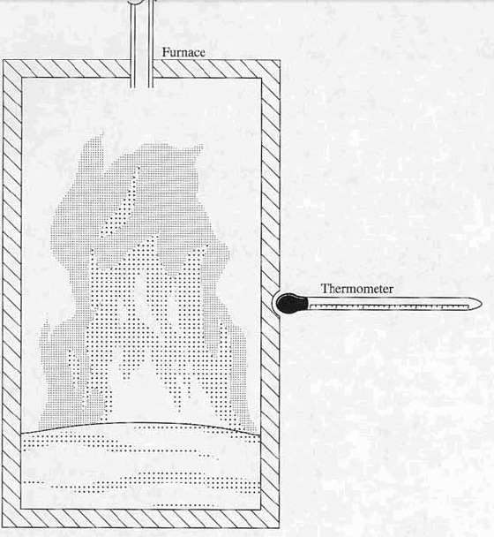
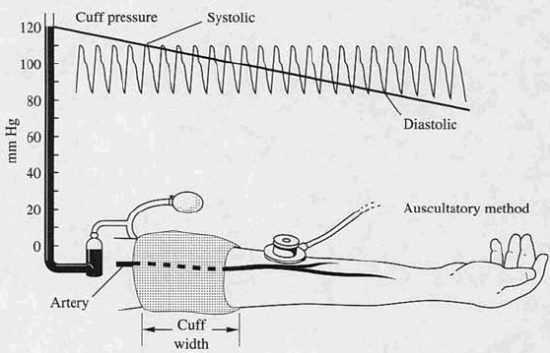
Measuring point on a furnace
Indirect Measurement of blood pressure

Slide 22
Null Measurement
Null measurement are made by comparing a calibrated source to an unknown measurand and then adjusting either one or the other until difference between them is zero.
Example: An electrical potentiometer is such an instrument; it is an adjustable calibrated source and a comparison meter (galvanometer). The reference voltage from the potentiometer is applied to one side of the zero center galvanometer, and the unknown is applied to the other side of galvanometer.
The output of the potentiometer is adjusted until the meter reads zero difference.

Slide 23
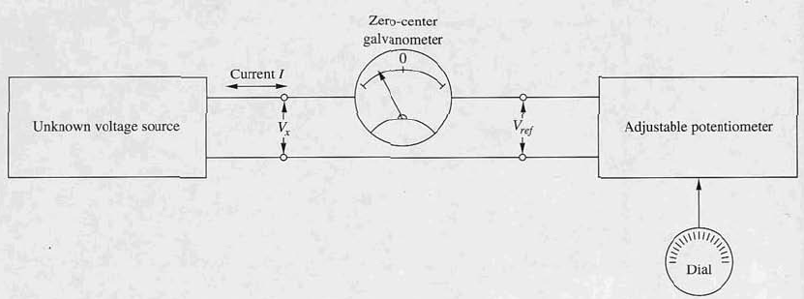
Example of Null Measurement

Slide 24
Instruments Operational Modes
Direct / Indirect Mode
Sampling and Continuous Modes
Generating and Modulating Modes
Analog and Digital Modes
Real time and Delayed Time Modes

Slide 25
Direct / Indirect Modes
Direct Mode
Desired measurand can be interfaced directly to a sensor because the measurand is readily accessible
If the sensor is invasive, direct contact with the measurand is possible but expensive, risky and least acceptable.
Temperature
Heartbeat
Indirect Mode
Desired measurand can not be interfaced directly and not accessible
Morphology of internal organ: X-ray shadows
Volume of blood pumped per minute by the heart: respiration and blood gas concentration
Pulmonary volumes: variation in thoracic impedance plethysmography

Slide 26
Sampling Mode and Continuous Mode
Sampling Mode
Sampling can change so slowly that they may be sampled infrequently.
Body Temperature
Ion Concentration
Continuous Mode
Frequent or constant monitoring of measurand
Electrocardiogram
Respiratory Gas Flow

Slide 27
Generating and Modulating Modes
Generating Mode
Generating sensors produce their signal output from energy taken directly from the measurand.
Also known as self-powered modes.
Example: Photovoltaic cell is a generating sensor because it provides an output voltage related to its irradiation, without any additional external energy source.
Modulating Mode
Modulating sensors use the measurand to alter the flow of energy from an external source in a way that affects the output of the sensor.
Example: Photoconductive cell is a modulating sensor; to measure its change in resistance with irradiation, we must apply external energy to the sensor.

Slide 28
Analog and Digital Modes
Analog Modes
Analogue or Continuous signal is able to take any value within a dynamic range.
Most currently available sensors operate in the analog mode.
Digital Modes
Digital or Discrete signal is able to take on only a finite number of values.
The advantages of the digital mode of operation include greater accuracy, repeatability, reliability, and immunity to noise.

Slide 29
Real Time and Delayed Time mode
Real Time Mode
Sensor acquire the signal in real-time mode
The result are displayed immediately
Delayed Time Mode
Display results are delayed due to image processing such as averaging and transformations.

Slide 30
General Constraint In Design of Medical Instrumentations Systems
Medical equipment are primarily used for making measurements of physiological parameters of the human body and also in some cases as stimulus or some kind of energy is applied to the human body for diagnosis and treatment.
Some of important factors, which determine the design of a medical measuring instrument, are:
Measurement Range: Generally the ranges are quite low compared with non-medical parameters. Most signals are in microvolt range.
Frequency Range: Most of the biomedical signals are in the audio frequency range or below and many signal contain dc and very low frequency components

Slide 31
Cont….
The signal to be measured imposes constraints on how it should be acquired and processed.
Many measurand in living systems are inaccessible.
Placement of sensor(s) in/on the body plays a key role in medical instrumentation design.
Magnitude and frequency range of medical measurand are very low.
Interference and cross-talk artifacts.
Proper sensor interface with measurand cannot be obtained.
Medical variables are seldom deterministic (varying with time).

Slide 32
Cont….
Many medical measurements vary widely among normal patients, even when conditions are similar.
Safety of patient and medical personnel also must be considered.
Safe levels of stimulation or applied energy are difficult to establish,
External energy must be minimized to avoid any damage.
Equipment must be reliable, easy to operate, and durable.
Government regulations.

Slide 33
Common Medical Measurands

Slide 34
Classifications Of Medical Instruments
Medical Instruments can be classified in the four categories
Quantity that Sensed
Principle of Transduction
Organ System
Clinical Medicine Specialties

Slide 35
Classifications
Quantity That Sensed
Advantage of this classifications is that it makes different methods for measuring any quantity easy to compare.
Pressure
Flow
Temperature
Principle of Transduction
Resistive
Inductive
Capacitive
Ultrasonic (Sound waves)
Electrochemical (pH probe, Hydrogen Sensor)

Slide 36
Cont…
Organ System
Isolates all important measurements for specialists who need to know only about a specific area
Cardiovascular Systems
Pulmonary System
Nervous System
Endocrine System

Slide 37
Cont….
Clinical Medicine Specialties
This approach is valuable for medical personnel who are interested in specialized instruments.
Pediatrics
Obstetrics
Cardiology
Radiology.

Slide 38
Measurement Input Sources
Desired Inputs: Measurands that the instrument is designed to isolate.
Interfering Inputs: Quantities that accidentally affect the instrument as a consequence of the principles used to acquire and process the desired inputs.
Modifying Inputs: Quantities that cause a change in the input –output relations of the instrument.

Slide 39
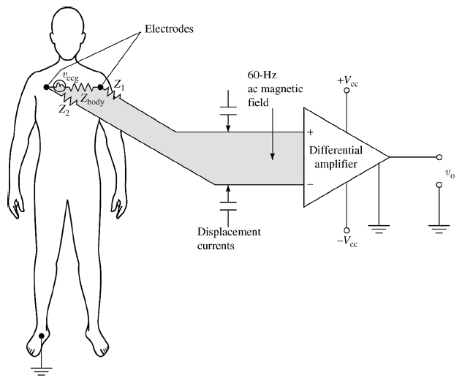
Example: ECG Signal Measurement
Desired Input: ECG voltage (Vecg)
Interfering Input: 60/50 Hz noise voltage, displacement currents
Modifying Input: – orientation of the patient cables when the plane of the cable is perpendicular to the magnetic field the magnetic interference is maximal
Figure: Simplified electrocardiographic recording system Two possible interfering inputs are stray magnetic fields and capacitive coupled noise. Orientation of patient cables and changes in electrode–skin impedance are two possible modifying inputs. Z1 and Z2 represent the electrode–skin interface impedances.

